Slide 1
Developing a Mission Strategy
Seshan Brothers

Slide 2
Objectives
Learn how to come up with a strategy for the robot game

Slide 3
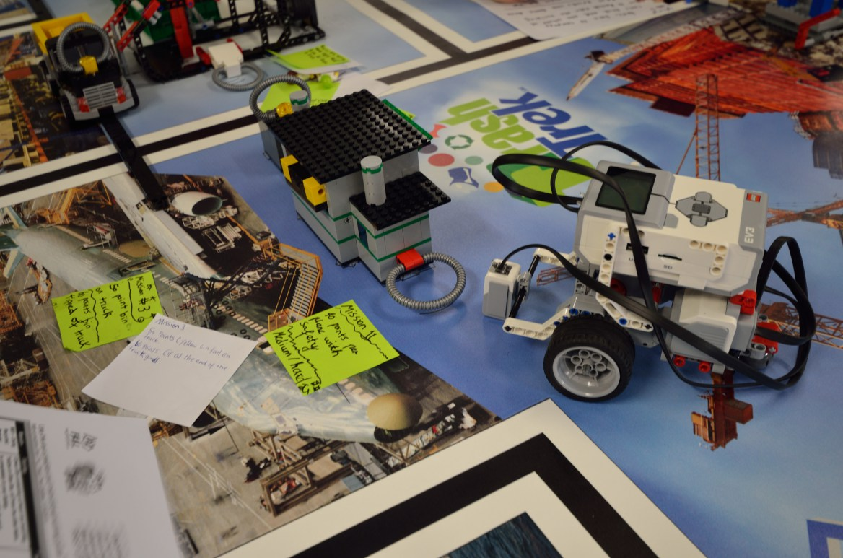
Step 1: Understand the Missions
Rule #1 is to read the Challenge Guide thoroughly – everyone should do this
Rule #2 is to read the Updates during the season
Tip: Many teams like to take notes on each mission (the rules, the points, etc.) and place them next to the missions on the mat.
Photo Credits: Michael Graffin, Iona Primary

Slide 4
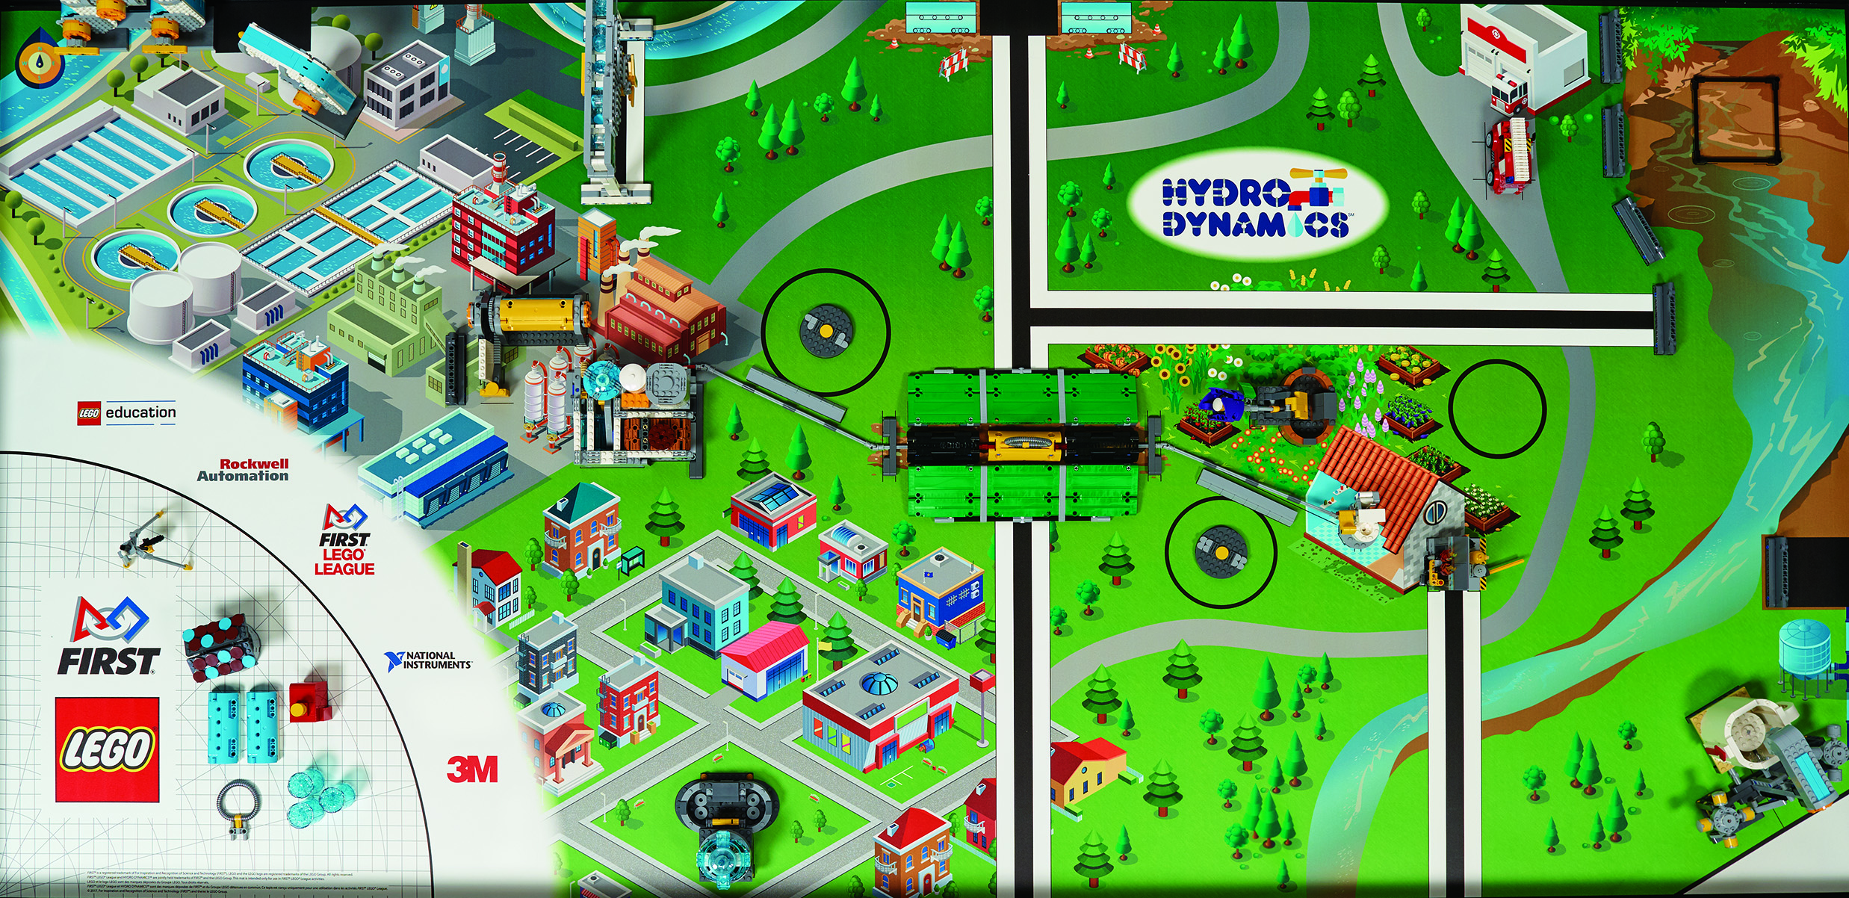
Step 2: Plan Your Robot Game
Which missions are near base and could be done quickly?
Which missions might be grouped together because of their proximity?
Which missions might use the same attachment/tool to complete?
Are some missions harder than others?
Are some missions harder to get to?
What are the team’s goals for the year when it comes to the robot game?
How many points is the mission?
Use the answers to the questions to determine which missions to do and when.
A Planning Guide is available on the next page.

Slide 5
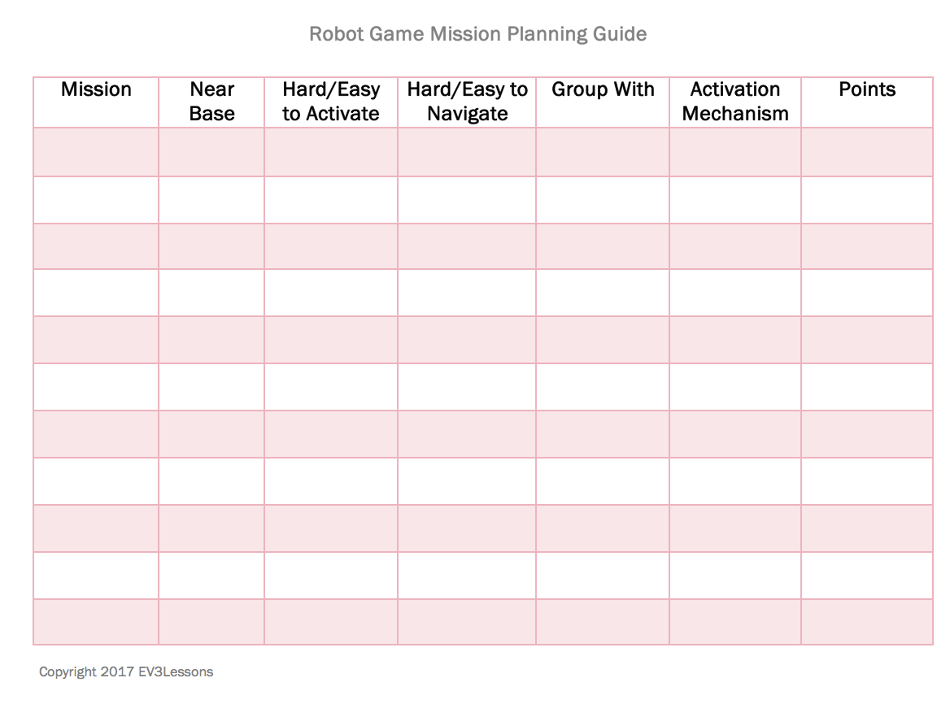
Step 2: Mission Planning Guide
Create a worksheet with all the missions
Use it to evaluate all your options for a given year’s robot game

Slide 6
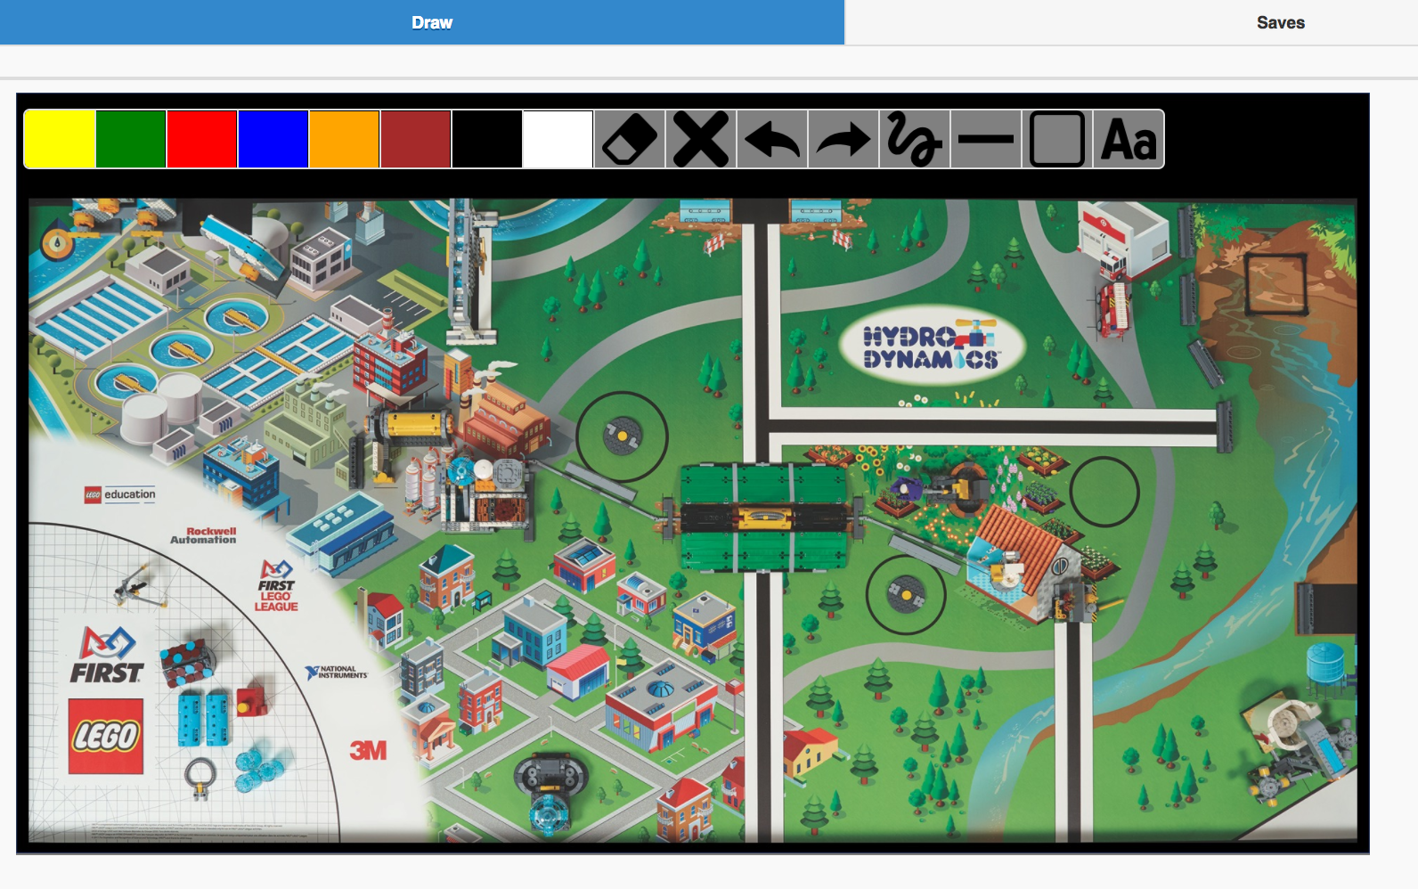
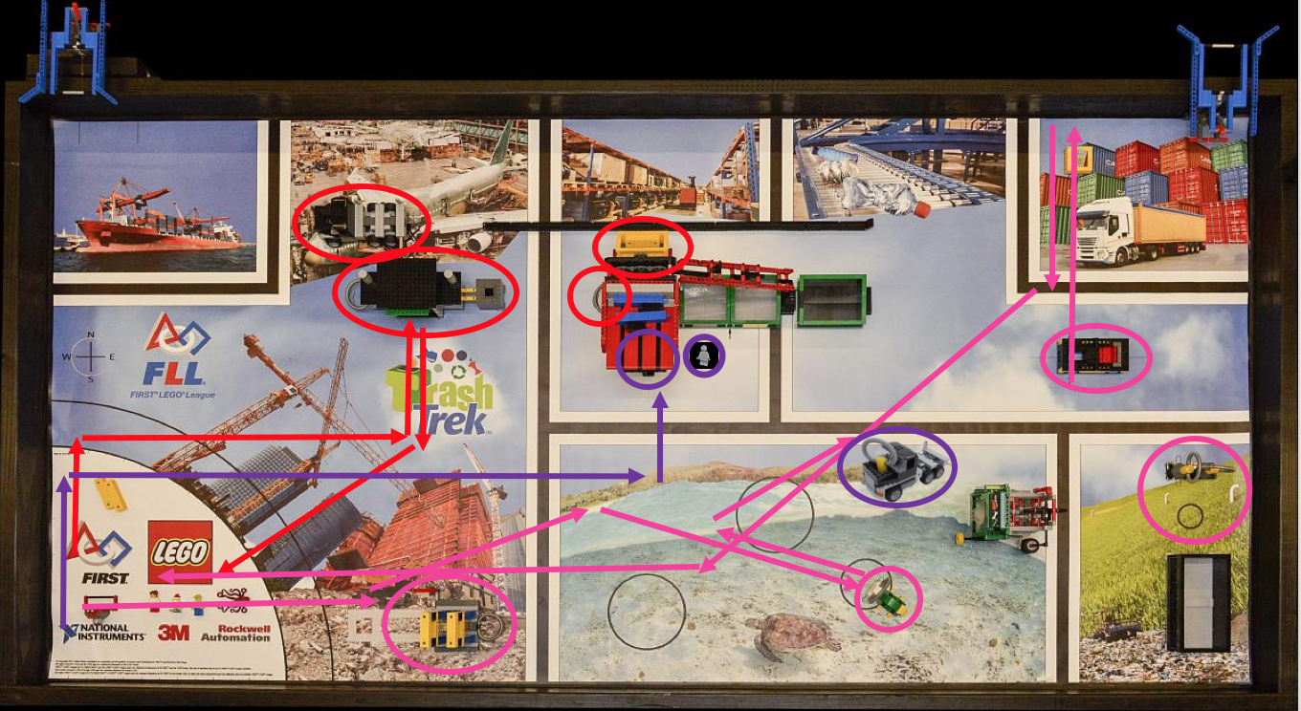
Step 3: Team Robot Game Strategy
Now, use an online tool such as our Interactive Strategy Planner to determine the path your robot will take
Each time you go out of base is called a “run”
Draw each run using a different color.
Or print out an image of the challenge mat and hand-draw
We recommend that each team member comes up with a strategy and then the team listens to all the ideas and combines them.

Slide 7
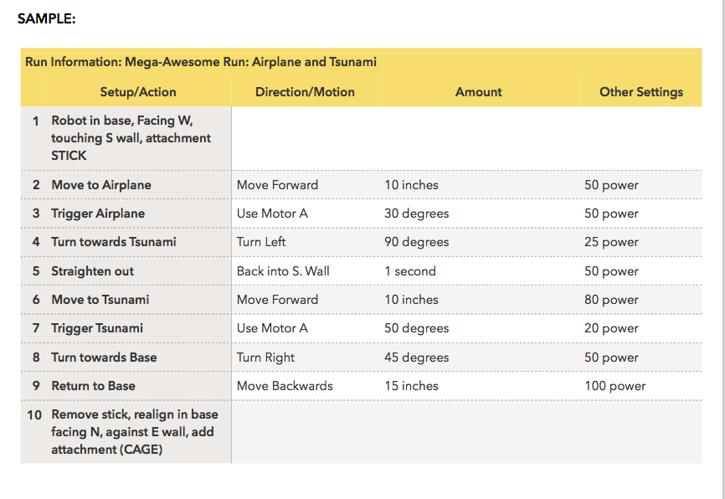
Step 4: Building & Programming
Once you have a strategy, start to build your robot and write Pseudocode for each “run”.
Read the Pseudocode lesson available on EV3Lessons.com

Slide 8
Some Thoughts
Remember that a robot game strategy may change over time
You might get a new idea or find a way to combine missions
You might build a different attachment
As a rookie team, complete missions closer to base first
Usually, they are easier to get to and easier to activate
When you finish those and can do them reliably, start to add more missions
You don’t need to do all the missions to “win”.
Doing the missions you can well can often yield better results than completing all the mission unreliably.
Example: We have won the robot performance award and Champion’s without completing all the missions

Slide 9

Credits
This lesson was written by Sanjay and Arvind Seshan
More lessons available at www.ev3lessons.com and www.flltutorials.com

